Slide 1
Fuzzy Joins using MapReduce
Anish Das Sarma
With: Foto N. Afrati, David Menestrina, Aditya Parameswaran, Jeffrey D. Ullman

Slide 2
Introduction
MapReduce (MR) is a popular paradigm for processing large amounts of data
Problem: Fuzzy (approximate) joins in MR
  Arise in entity resolution, collaborative filtering, clustering, etc.
Our goal: Solve fuzzy joins in:
  Single MR step
  Minimize cost

Slide 3
Outline
Definitions:
  Fuzzy joins
  Cost model
Algorithms for hamming-distance joins
Other results in paper & conclusions

Slide 4
Fuzzy Joins
Goal: Find pairs of records within some distance of each other based on a distance measure
Input:
  Set S of records, from a domain D
  Distance function Dist: D×D→R
  Threshold T
Output:
  {(x,y) | x, y ε S, Dist(x,y) ≤ T}

Slide 5
Example: Distance Measures
Strings:
  Edit-distance, Jaro-Winkler, …
  SecondString: JAVA string similarity package
  Transformations: “Bob”=“Robert”, “Blvd.”=“Boulevard”
Sets: Jaccard distance, …
Bit vectors: Hamming distance, …
Numerical: difference, ….

Slide 6
Hamming Distance
Given b-bit vectors s, t, hamming distance HD(s,t) is the number of bits in which s and t differ
Example:
  b=4, input S={0010, 0111, 1111}
  Threshold d=2 ➔ find all pairs with HD≤2
  Output: (0010,0111), (0111,1111)
This Talk: Focus on Hamming-Distance only; paper also considers Edit-distance, Jaccard-distance

Slide 7
MR Cost Model
Cost: MR algorithm has following costs
  Map Cost (M): Processing across all inputs
  Communication Cost (C): Passing data from mappers to reducers
  Total Reducer Cost (R): Total computation cost across all reducers
Parameters: Costs expressed using:
  Size of input dataset:|S|
  Threshold d on maximum distance
  Size b of input vectors; denote n=2^{b}
  Number of reducers K
Goal: Find algorithms on the “skyline” of optimality in terms of costs (M, C, R)

Slide 8
Assumptions
Input set S is random ➔ hashing the inputs equally divides input among reducers
Simple operations such as copying/comparing/hashing input elements require unit time
Map phase operates independently on each input element
We compute average costs (per input for M, per reducer for R)

Slide 9
Outline
Definitions:
  Fuzzy joins
  Cost model
Algorithms for hamming-distance joins
Other results in paper & conclusions

Slide 10
Warm-up: Naïve Algorithm
i
reducer (i, j)
0≤i≤j<J; J≈√K
hash(e1)=h1=1
hash(e1)=h2=0
h1
h1
j
Map:
  Hash each element into J buckets
  When hash=h, element sent to all reducers (h,j) and (i, h)
Costs:
  M=C=O(|S|√K)
  R=O(|S|²)
Given K reducers, create a triangle
Reducer compares each pair it receives

Slide 11
Hamming Distance Algorithms
Key Challenges:
  Minimizing cost (M, C, R)
  Ensuring each result pair output on only one reducer
Algorithms: We present multiple algorithms, each non-dominated in the (M,C,R) space:
  Ball-hashing-1
  Ball-hashing-2
  Splitting
  Anchor Points
Next:
  Summary of results
  Key ideas of each algorithm

Slide 12
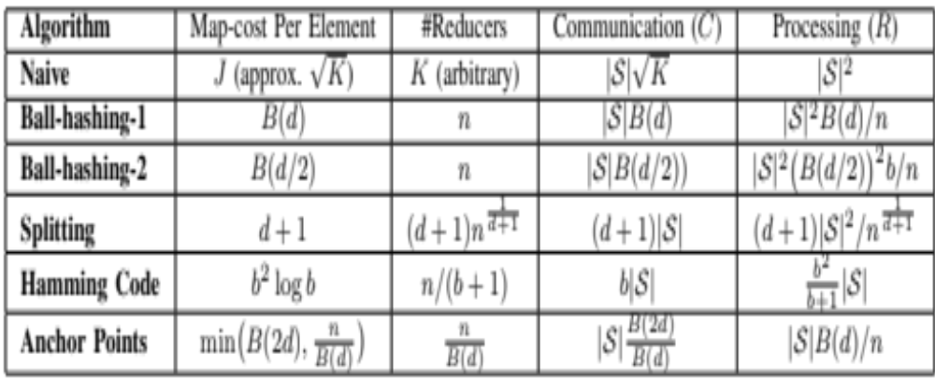
Summary of Results

Slide 13
Ball-Hashing-1
Reducer for each of n=2^{b} possible strings ‘t’: reducer(t)
Each string ‘s’ sent to reducers for all strings at distance ≤d
If t ε Reducer(t), then compare ‘t’ with all other smaller strings (note: don’t compare all pairs at each reducer)
d
Reducer(t)
s
t
s,t compared here
Map cost per input = size of ball B(d)≈b^{d}
Communication = |S|B(d)
Each reducer receives≈|S|B(d)/n strings; therefore, reducer cost = |S|²B(d)/n

Slide 14
Ball-Hashing-2
Reducer for each of n=2^{b} possible strings
Each string ‘s’ sent to reducers for all strings at distance ≤ d/2
Compare s1,s2 at reducer(t) iff t is the smallest intermediate string between s1 and s2
  “Smallest intermediate” reducer to ensure same pair (s1,s2) not produced in multiple reducers (computed in O(b); details omitted)
d/2
d/2
Map cost = B(d/2)
C = |S|B(d/2)
R= b|S|²B(d/2)²/n
s1
t
s2
s1, s2 compared at reducer(t)

Slide 15
Splitting
Key Idea:
  Divide each string into (d+1) pieces
  If HD(s1,s2)≤d, then at least one piece is identical
Map each string to one of 2^{(b/(d+1))} reducers based on each of the (d+1) pieces
Each reducer outputs a pair if no previous piece is also identical
s1
0 | 0 | 0 | 1 | 1 | 1 | 1 | 0 | 0 | 0 | 0 | 1 | 0 | 0 | 1 | 1 | 1 | 0
Reducer(001110)
s2
0 | 1 | 0 | 1 | 1 | 0 | 1 | 0 | 0 | 0 | 0 | 0 | 0 | 0 | 1 | 1 | 1 | 0
Map cost = (d+1)
Communication = |S|(d+1)
Reducer for each piece receives≈|S|/2^{(b/(d+1))} strings;
R=|S|²(d+1)/2^{(b/(d+1))}

Slide 16
Anchor-Points
Use set A of anchor points, such that all b-bit strings are at most d-bits away from some anchor point
Clearly |A|≥n/B(d); we show in the paper that a randomized algorithm achieves |A|≈nlogn/B(d). We assume |A|=n/B(d) for now.
Reducers corresponding to anchors
Map each string s to all aεA with HD(s,a)≤2d
2d
s
Reducer
(Anchor t1)
t2
t1
Reducer
(Anchor t2)

Slide 17
Anchor-Points (contd.)
Map each string s to all aεA with HD(s,a)≤2d:
  Search in O(1) each anchor: B(2d)
  Scan all anchors: n/B(d)
  Therefore, min(B(2d),n/B(d)))
Compare string s to all strings at the home reducer of s, i.e., the closest anchor
Since prob. of each string being anchor=1/B(d), communication = |S|B(2d)/B(d)
Reducer cost = |S|B(d)/n

Slide 18
Summary

Slide 19
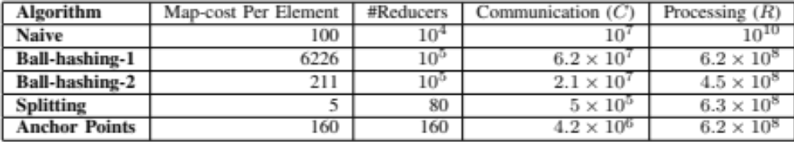
Summary (contd.)
Paper gives detailed analysis for each algorithm
No algorithm (except Naïve) dominated by others
Examples costs using b=20, d=4, |S|=10⁵, K=10⁴
The “best” algorithm can be chosen based on application requirements, number of machines, etc.

Slide 20
Outline
Definitions:
  Fuzzy joins
  Cost model
Algorithms for hamming-distance joins
Other results in paper & conclusions

Slide 21
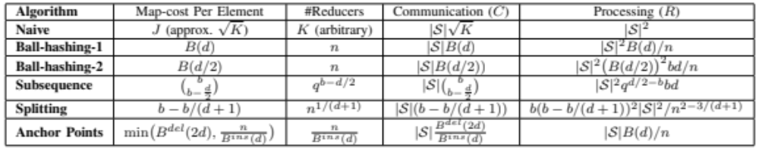
Other Results
Explored edit-distance in detail
Used similar ideas, and obtained results for a number of algorithms
Jaccard distance handled using edit-distance
  Leverage previous work on sorted-string representations of sets

Slide 22
Related Work
R. Vernica, M. J. Carey, and C. Li, “Efﬁcient parallel setsimilarity joins using mapreduce,” in SIGMOD ’10.
A. Okcan and M. Riedewald, “Processing theta-joins using mapreduce,” in SIGMOD ’11.
F. N. Afrati and J. D. Ullman, “Optimizing joins in a mapreduce environment,” in EDBT, 2010

Slide 23
Open Questions
[Ongoing & Future Work]
Are there any lower bounds on fuzzy joins?
Can we explicitly tradeoff communication for the other costs?
Key Idea [Cloud Futures 2012]:
  If we know how many outputs each input (or set of inputs) can generate, can we bound the number of outputs at each reducer based on communication?

Slide 24
Thanks!
Anish Das Sarma
Google Research
anish.dassarma@gmail.com

