Slide 1
Why is this data here?
Anish Das Sarma

Slide 2

Understanding Derived Data
Input
Part-1: SQL Query
Op
Part-2: Information Extraction
Output

Slide 3
Outline of The Talk
Part 1: Synthesizing View Definitions from Data
  [ICDT 2010: Anish Das Sarma (Y!), Aditya Parameswaran, Hector Garcia-Molina, Jennifer Widom (Stanford)]
Part 2: Investigating Information Extraction
  [SIGMOD 2010: Anish Das Sarma, Alpa Jain (Y!), Divesh Srivastava (AT&T)]
Part 3: 60-second overview of our group at Y! research

Slide 4
Part 1: Synthesizing View Definitions from Data
View Definitions Problem
Input: Database D, View V
Output: Find Q such that:
  Closeness: Q(D)≈ V (“level of approximation”)
  Succinctness: Q is “succinct”

Slide 5
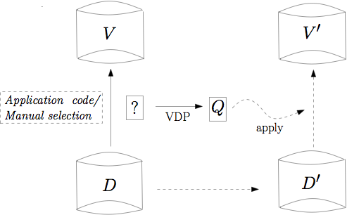
1-Slide Motivation

Slide 6
View Definitions Problem
View Definitions Problem
Input: Database D, View V
Output: Find Q such that:
  Closeness: Q(D)≈ V (“level of approximation”)
  Succinctness: Q is “succinct”
(1) What class of queries?
(2) What error is tolerable?
(3) Metric of succinctness?

Slide 7
1. Classes of Queries
R,V
Q. Q(R)≈V
Single Predicate
Conjunctive Query (CQ)
Unions of CQs
At most ‘k’ unions of CQs
Equality Predicates
Range Predicates
2. Succinctness
Conjunctive Query: Number of predicates
Unions of CQs: Number of unions

Slide 8
3. Closeness
R,V
Q. Q(R)≈V
Exact View Definition. Given R,V, find Q s.t. Q(R)=V.
… but may not have a solution, or non-unique solution
Best View Definition. Given R,V, find Q s.t.
d(Q(R),V) ≤ d(Q’(R),V)
d(Q’(R),V) = d(Q(R),V) ➔ s(Q) ≤ s(Q’)
BVD: |Q(R)-V|+|V-Q(R)|
BVD-Sub: |V-Q(R)|+ ∞|Q(R)-V|
BVD-Sup: |Q(R)-V|+ ∞|V-Q(R)|
Approximate View Definition. Given R,V, τ, find Q s.t.
d(Q(R),V) ≤ τ
d(Q’(R),V) ≤ τ ➔ s(Q) ≤ s(Q’)

Slide 9
Example
R
V
Movie | Genre | Box Office
Kill Bill | Action | Hit
Pulp Fiction | Comedy | Hit
Snatch | Comedy | Hit
1941 | Comedy | Flop
The Godfather | Action | Hit
Movie | Genre | Box Office
Kill Bill | Action | Hit
Pulp Fiction | Comedy | Hit
Snatch | Comedy | Hit
Q
CQ: (Box office = Hit)
Dist = 1
UCQ: ((Box office = Hit)∧(Genre=Comedy))
∨ (Movie=Kill Bill)
Dist = 0

Slide 10
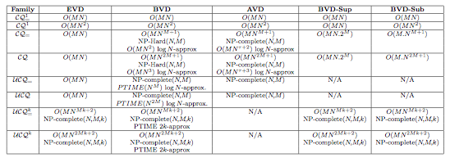
Summary of Results
1. Conjunctive queries
2. k-Unions of CQs

Slide 11
Conjunctive Queries
Finding best view definition is NP-hard
Reduction from Set Cover
Set Cover Instance:
Universe: U = {1, 2, …, n}
Sets: S1, S2, …, Sm
Fewest sets covering U
VDP:
R(A1, A2, …, Am)
t0, t1, t2, …, tn ε R. V=t0. Find smallest CQ: Q(R)=V
R | A1 | A2 | …Aj | Am
t0
t1
…ti
tn
Step-1: 0 if i not in Sj
0
0
0
0
1) Aj = 0 <==> picking Sj
Step-2: t0.Aj = 0
0
1
0
2
3
0
0
4
2) Eliminate all ti, i>0
=> Cover all i=1..n
Step-3: all distinct
5
6
7
0
Step-4: V = {t0}

Slide 12
Conjunctive Queries ➔ Set Cover
U=R-V
R
P1
P2
All Pi(R) V
|U
P3
V
Pk
EVD: Exact
BVD, AVD: Approximate
Cover U with fewest sets

Slide 13
K-Unions
R(A1, A2, …, Am), V ➔ Find k-unions Q s.t. d(Q(R),V) minimized
NP-Hard in m, k (omitted from the talk)
Greedy approximation algorithm => weak guarantee
Inapproximability of greedy under stronger notion

Slide 14
K-Unions: A Greedy Approach
V
C1
good
One line algorithm:
At each step, pick Ci with
max (good – bad)
C2
C3
R-V
bad
Cr

Slide 15
K-Unions
V
Two distance metrics:
d: X+Z
gb: Y-X
Y
good
Approximation ratios:
R_{d} = d_{algo}/d_{opt}
R_{gb} = gb_{opt}/gb_{algo}
Q
Z
bad
X
No greedy algorithm can achieve bounded (independent of |V|) approximation ratio R_{d} or R_{gb}
Good News: Greedy ensures min (R_{d},R_{gb}) ≤ 2k
Proof Idea:
Bad R_{gb}: No CQ with gb>0, but all bads coincide
Bad R_{d}:
* One CQ with N good tuples and (N-N/k) bad tuples
* k CQs with N/k good tuples and same 1 bad tuple
R-V

Slide 16
2k-approx: Proof Sketch
V
d_{opt}=X+Z; gb_{opt}=Y-X
Y
good
Exists Q* with ≥Y/k good and ≤X bad tuples
Q_{opt}
Z
d* ≤ (X + Y + Z - Y/k)
gb*≥ (Y/k - X)
bad
X
Setting β = (y-x)/(y/k-x):
R_{gb} ≤ β
R_{d} ≤ 1 + (k-1)(β-1)/(β-k)
R-V
For all β: min (R_{gb}, R_{d}) ≤ 2k
Open Question: Better upper/lower bounds (for greedy or other algorithms)

Slide 17
Part-1: Summary
Sample of results for VDP – more in the paper
View Definitions Problem
Input: Database D, View V
Output: Find Q such that:
  Closeness: Q(D)≈ V (“level of approximation”)
  Succinctness: Q is “succinct”
(1) What class of queries?
(2) What error is tolerable?
(3) Metric of succinctness?

Slide 18
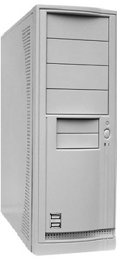

Part 2: Information Extraction
Reboot!
or, wake up!

Slide 19

Information Extraction (IE)
IE systems automatically generate relations from text documents (e.g., web pages)
IE users or developers may perform a post-mortem analysis of output
Goal: Build an (interactive) investigation tool for IE
Acted-in
Movie | Actor
Top Gun | Tom Cruise
24 hours | Nicole Kidman
Hollywood | Brad Pitt
… | ….
Information extraction
Crawl index
?

Slide 20

Iterative Information Extraction from Text
crawl
Seed tuples
Discover patterns
Discover tuples
Append reliable tuples
Prune tuples
Prune patterns
Unexpected tuples in output
Example extractions: Starting from 10 examples
  {Book, Author} ➔ 122,337
  {Movie, Actor} ➔ 237,414
  {Movie, Director} ➔ 210,766
  {Musician, Band} ➔ 120,354
  {Organization, CEO} ➔ 142,302
Tuple:
<Star Wars, Alec Guinnes>
Pattern:
<m> films starring <a>
Tuple:
<Hollywood, Brad Pitt>

Slide 21
Investigation Tool Desiderata
Explain
  Keep track of what you’ve extracted and integrated
  Why is a data item (not) present in the result?
    e.g., “<hollywood, brad pitt> was generated by pattern p”
Diagnose
  What would happen if an operator (e.g., threshold) was modified?
  What is the impact of modifying input data (e.g., pattern)?
    e.g., “pattern p gave the most number of tuples”
Repair
  Fix the IE execution when you have feedback on output
    e.g., “I know tuples <t1>, <t2> are wrong, and <t3> is correct; fix output”
  Suggest potential problems automatically, to guide debugging

Slide 22
Designing Interactive Investigation Tools
Maintain auxiliary information to facilitate debugging
  What is the right model for lineage and data?
  How can we re-construct data and control flow?
Build efficient algorithms to address various questions for each phase
Maximize gains from user interaction by focusing on “important” areas of execution

Slide 23
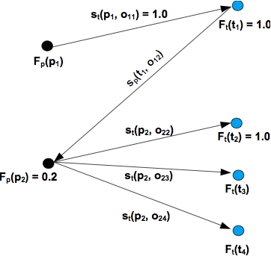
I4E: Overview of Our Approach
(Interactive Investigation of Iterative Information Extraction)
We characterize each iteration using an Enhanced Bipartite Graph (EBG)
As IIE progresses, maintain tracing information in EBG
Answer questions on an iteration using corresponding EBG
Answer questions across iterations by chaining EBG
patterns
tuples
causal links

Slide 24
Example: Identify Influential Patterns
Why?
  Not all patterns have the same impact on extraction
  Limited editorial resources
  Best patterns to seek feedback on
Defining influence of a (set of) patterns ‘p’ based on:
  I₁: Confidence score of p (naïve?)
  I₂ : Number of tuples produced by p
  I₃ : Number of tuples only p produced
  I₄ : Total score contribution of p over all tuples

Slide 25
Select Influential Patterns Using EBG
Rank all patterns by influence
  Near-linear time algorithms for all I*
  EBG contains sufficient information
Find most influential set of k patterns
  Near-linear time for I₁, I₃, I₄
  NP-complete for I₂
  Constant-factor approximation for I₂

Slide 26
Details in the Paper
Similar study for influential tuples
Repair
  Suppose some tuples are marked correct or wrong (by editors), what can you infer about other tuples?
Chaining
  Composing the primitive explain, diagnose, repair operations to perform more complex investigation
Skip to experiments

Slide 27
Experimental Evaluation
Extraction using Wiper (Y! Labs) on 6 domains
  actors, books, directors, mayors, senators, political-party
  Web pages in a Y! index sample of ~500M documents
Size of relations varying from 2,000 to 250,000
Goal: Initial feedback on the utility of the I4E framework
  Is influence a useful measure?
  Is overhead manageable?
Presenting results on the books relation: 140K tuples

Slide 28
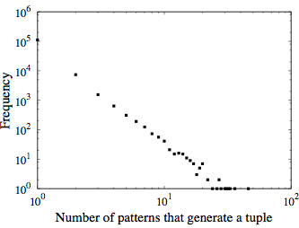
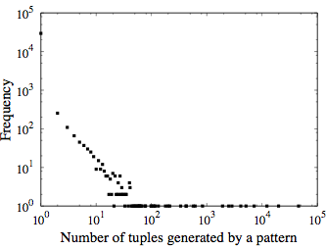
Statistics

Slide 29
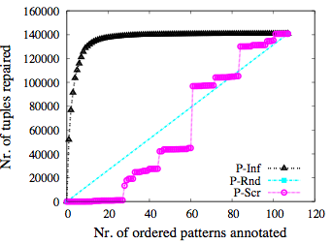
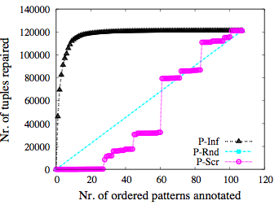
Repaired Tuples for Annotated Patterns
When pattern is correct
When pattern is wrong

Slide 30
Space and Time Overhead for I4E
For each domain:
  Between 5 and 100% space overhead (depending on what “overhead” means)
Studied the overhead-coverage tradeoff

Slide 31
Ongoing Work
[With: Philip Bohannon, Arup Choudhury, Alpa Jain, others]
Debugging for generic information extraction
  Non-iterative pipelines
  With limited information about extraction operations

Slide 32

Part 3: 60-second overview of our group at Y!

Slide 33
Web Information Management
Web-Scale Data Management (Sherpa)
Information Extraction* (PSOX)
Content Recommendation (COKE)

Slide 34
PSOX Project
Umbrella project around information extraction and managing extracted information
  Deep Web, Provenance, Extraction Robustness, Noisy Training, Joint Extraction and Integration, User Intent Analysis, Privacy, Content Matching
Joint work between Web Information Management, Machine Learning and Search Sciences
CA: 7, BLR: 6, NY: 1
Collaborations with universities

Slide 35
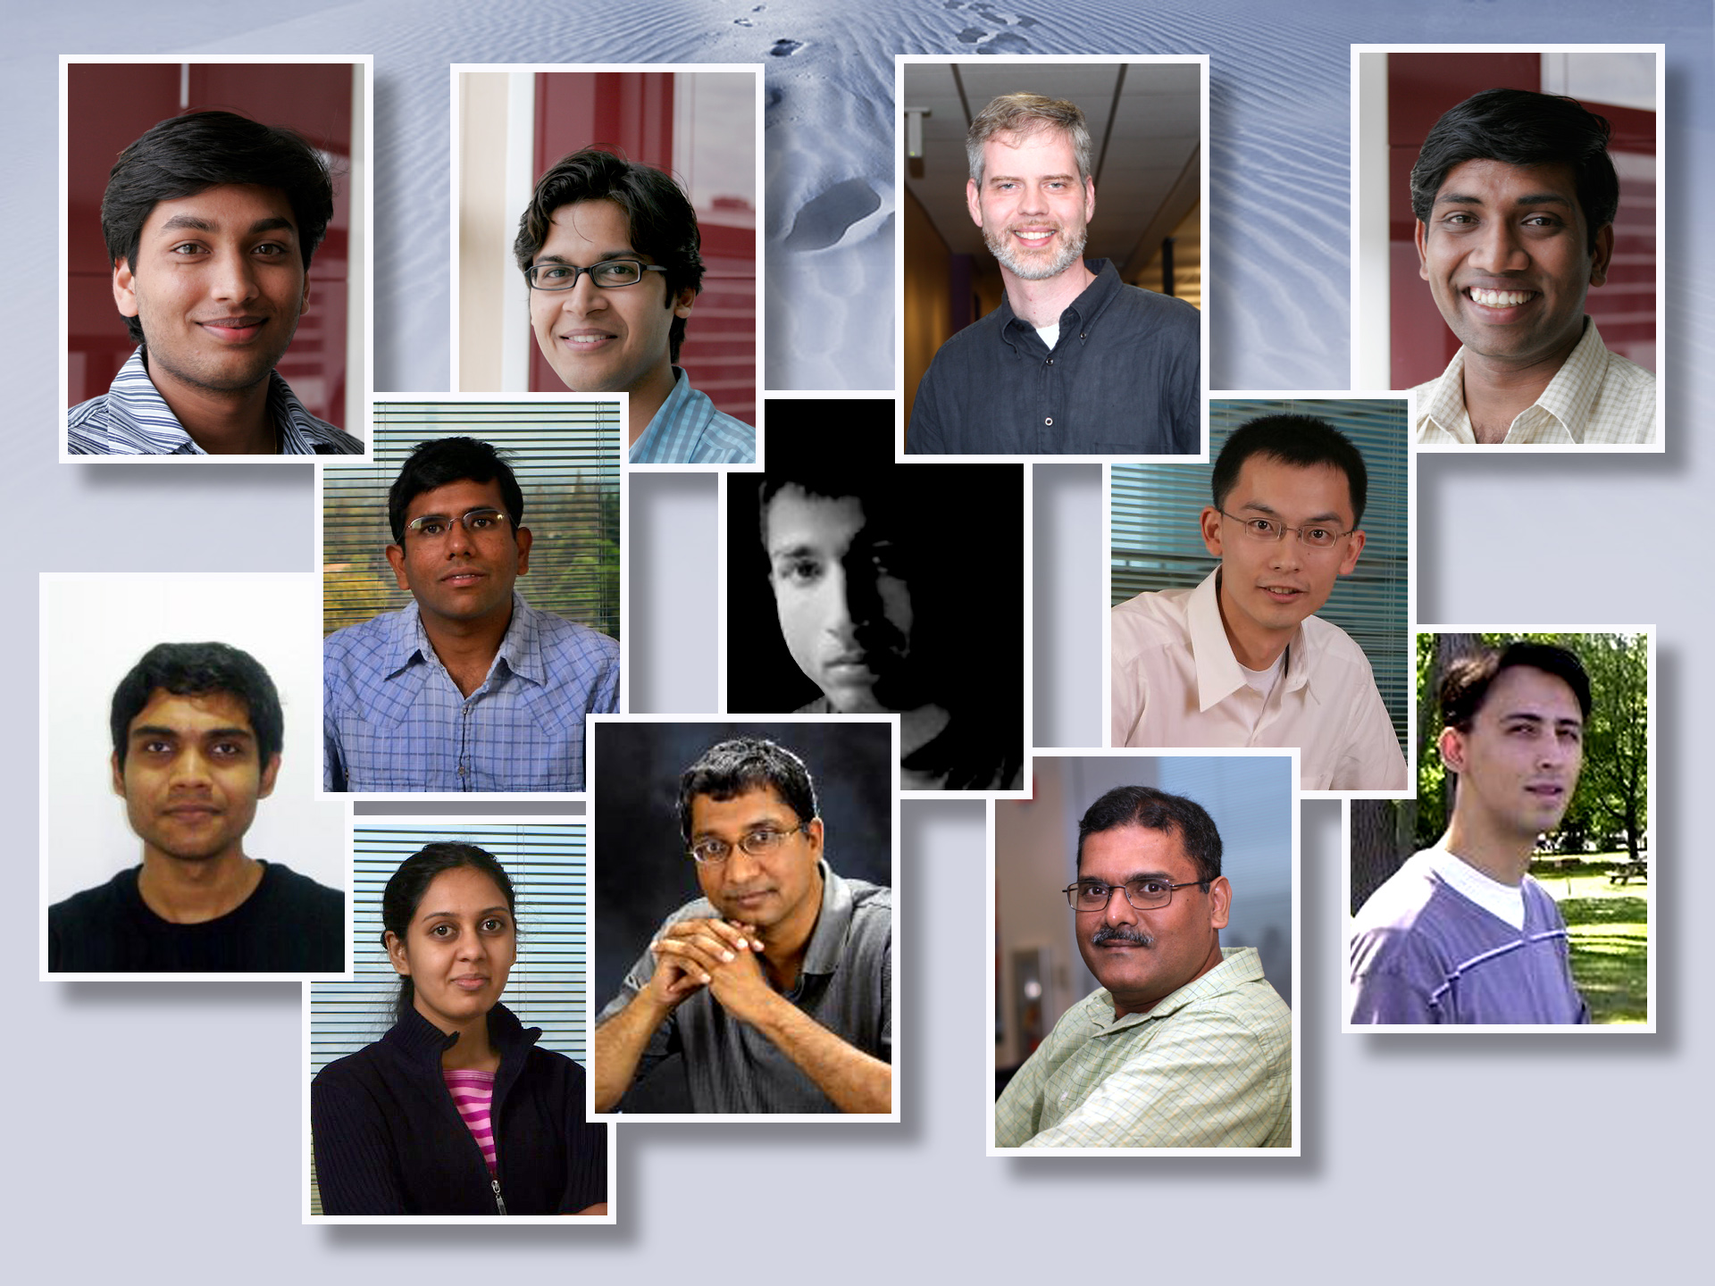

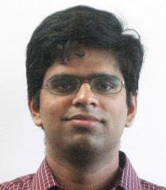


Slide 36
Thanks!
Anish Das Sarma
anishdas@yahoo-inc.com

Slide 37
K-Unions
Two distance metrics:
gb : tuples in V – tuples in (R-V)
d : |V| - gb
Both have terrible hardness of approximation!
I will illustrate this for a very special case:
greedy “function”: f(Pi) = ax – by
for the gb metric

Slide 38
Inapproximability
P1
R1
P2
R2
P3
R3
Pk
Rk

