Slide 1
Efficient Spatial Sampling of Large Geographical Tables
Anish Das Sarma, Hongrae Lee, Hector Gonzalez, Jayant Madhavan, Alon Halevy
Google Research

Slide 2
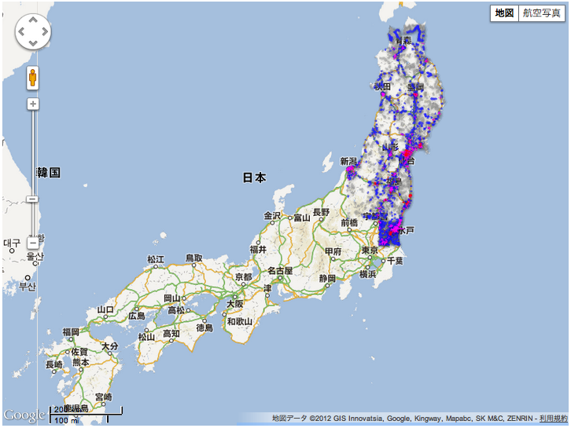
Japan Tsunami, March 2011

Slide 3
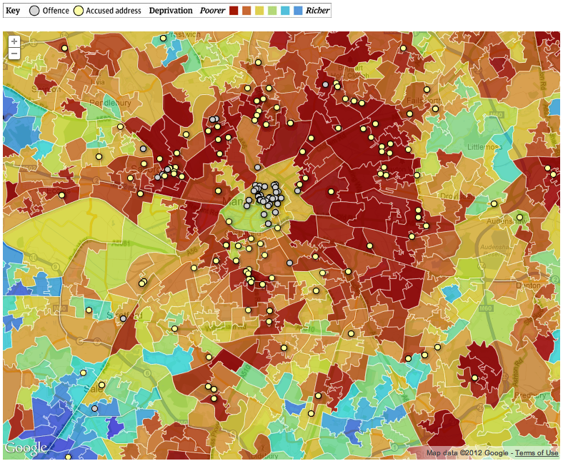
England riot suspects v.s. poverty

Slide 4
Introduction
Study visualization of geographic data on a map
Example commercial tools:
  Google Fusion Tables
  Google/Yahoo/Bing Maps
We address efficiency challenges in visualizing large datasets: The Thinning Problem

Slide 5
The Thinning Problem
Geographical data:
  Set of records
  Each record associated with:
    geographic feature (sub-region of the world): points, lines, polygons
    structured data: record-id, attributes
Map visualization:
  Input: region of the world (“tiles”) at a specific zoom level
  Output: display features in the region

Slide 6
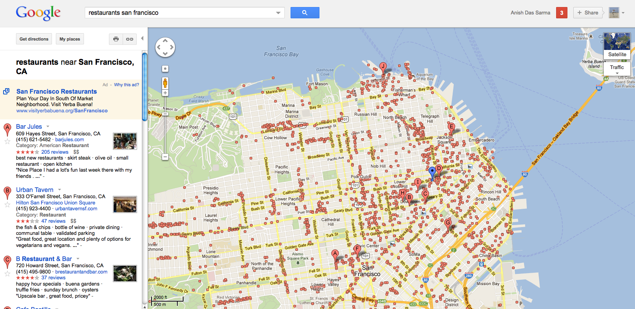
The Thinning Problem (contd.)
Datasets can be very large (e.g., 60M US parcels)
  Can show only a sample of records on the map
Our Goal: Determine (a priori), the set of records to be shown for a given tile, zoom level.
Dataset of 300K (geocoded) restaurants in US
When map is zoomed in to San Francisco (say zoom level z=5), cannot show all restaurants

Slide 7
Outline
Thinning problem:
  Formal definitions
  Challenges
General Framework for solving Thinning
Specific solutions

Slide 8
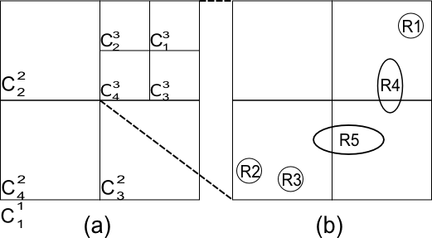
Example

Slide 9
Definitions: Geographical Data
Spatial Tree T(Z,N), Z≥1
Balanced 4-ary rooted tree
Z levels (~20 for Google Maps)
4^{(z-1)} nodes at level-z, denoted N^{z}={c₁^{z}, c₂^{z}, …}
z=1
z=2
Region R(S) over T(Z,N)
S C N^{Z}. |S|≥1
R(S) is point region if |S|=1
z=3
Geographical Dataset (GeoSet)
G = {R1, …, Rn}
Ri is a region corresponding to record ‘i’
R1

Slide 10
Thinning Constraints
Visibility Bound: Each tile can show a maximum of K (~500) features
Adjacency: Features spanning multiple adjacent tiles must be shown entirely
Zooming: If a feature is shown at a zoom level, it should be preserved by zooming in further

Slide 11
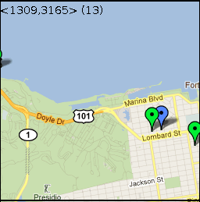
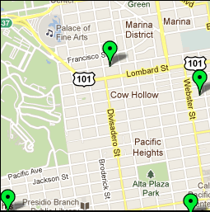
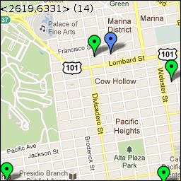
Example Violation of Zooming Constraint
Violation of
Zooming Constraint
Correct zoom in

Slide 12
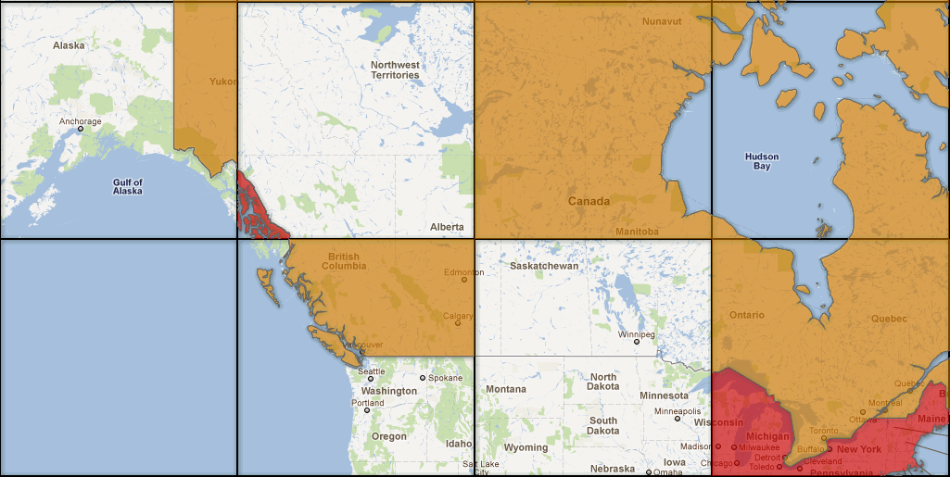
Example Violation of Adjacency Constraint

Slide 13
The Thinning Problem
Input:
Geoset G = {R1, ..., Rn} over a spatial tree T(Z,N)
Bound K ∈ N on the number of visible records in any cell
Output: a function min-level M : {1,...,n} → {1, …, Z, Z + 1}
Such that: ∀c^{z}_{j}∈N , z ≤ Z: |VisM(G,T, c^{z}_{j})| ≤ K
- VisM(G,T, c^{z}_{j}) is visible records at c^{z}_{j} = {Ri|(c^{z}_{j}∈span(Ri))&(M(j)≤z)}
Adjacency constraint
Visibility Bound
Zooming constraint

Slide 14
Why is the problem hard?
Scale: Thinning needs to be performed very efficiently
Constraints: Several constraints need to be met by any thinning solution
Objectives: There may be multiple solutions, and the best one needs to be picked based on certain desirable criteria

Slide 15
Our Contributions
General Framework based on LP
Specific solutions:
  (Strong & Weak) Maximality, DFS algorithm
  Point Dataset: Efficient randomized algorithm

Slide 16
Outline
Thinning problem:
  Formal definitions
  Challenges
General Framework for solving Thinning
Specific solutions

Slide 17
Selecting Features With Constraints
K = 2 (max 2 features per tile)
1 zoom level
f1
f3
f5
f2
f6
f4

Slide 18
Selecting Features With Constraints
K = 2 (max 2 features per tile)
1 zoom level
f1
f5
f2
f6
Possible solutions:
  (f1, f2) - (f5, f6)

Slide 19
Selecting Features With Constraints
K = 2 (max 2 features per tile)
1 zoom level
f1
f3
f5
f2
f6
f4
Possible solutions:
  (f1, f2) - (f5, f6)
  (f1 or f2) - (f3 or f4) - (f5 or f6)

Slide 20
Selecting Features With Constraints
K = 2 (max 2 features per tile)
1 zoom level
f3
f4
Possible solutions:
  (f1, f2) - (f5, f6)
  (f1 or f2) - (f3 or f4) - (f5 or f6)
  (f3, f4)

Slide 21
Selecting Features With Constraints
K = 2 (max 2 features per tile)
1 zoom level
f1
f3
f5
f2
f6
f4
Possible solutions:
  (f1, f2) - (f5, f6)
  (f1 or f2) - (f3 or f4) - (f5 or f6)
  (f3, f4)
  Subsets of the above

Slide 22
Selecting Features With Constraints
K = 2 (max 2 features per tile)
1 zoom level
f1
f3
f5
f2
f6
f4
Possible solutions:
  (f1, f2) - (f5, f6)
  (f1 or f2) - (f3 or f4) - (f5 or f6)
  (f3, f4)
  Subsets of the above
Which one is the best solution?

Slide 23
Optimization Framework: Key Ideas
P1
P2
P3
T1
1) Partitions
P1: features shown only in T1
P2: features shown in both T1 & T2
P3: features shown only in T2
T2
f1
f3
f5
f2
f6
2) Variables (for each zoom level)
x: # features to show from P1
y: # features to show in P2
z: # features to show in P3
f4
x
y
z
3) Constraints
0 <= x + y <= 2 (constraint from T1)
0 <= y + z <= 2 (constraint from T2)
0 <= x <= 2 (constraint from P1)
0 <= y <= 2 (constraint from P2)
0 <= z <= 2 (constraint from P3)
4) Objective
maximize: x + y + z
(show as many features as possible)

Slide 24
General Framework (overview)
Partition set of features into P1, P2, ... based on tiles spanned by features
Integer Variables X(i,j) - number of features from Pi with minimum-zoom-level = 'j'
Main Constraints:
  For each tile 'T': Sum of all variables contributing to T <= K (500)
  Sum_j: X(i,J) <= |Pi|

Slide 25
Optimization Framework: Key Ideas
P1
P2
P3
Theorem: Given Thinning problem instance G={R1, …, Rn} over T(Z,N), equivalent integer program formulation with O(nZ) variables and O(4^{Z}) constraints.
T1
1) Partitions
P1: features shown only in T1
P2: features shown in both T1 & T2
P3: features shwon only in T2
T2
f1
f3
f5
f2
Problems:
Large program size
Formulating Objectives
Solving the program
f6
2) Variables (for each zoom level)
x: # features to show from P1
y: # features to show in P2
z: # features to show in P3
f4
x
y
z
3) Constraints
0 <= x + y <= 2 (constraint from T1)
0 <= y + z <= 2 (constraint from T2)
0 <= x <= 2 (constraint from P1)
0 <= y <= 2 (constraint from P2)
0 <= z <= 2 (constraint from P3)
4) Objective
maximize: x + y + z
(show as many features as possible)

Slide 26
Details: Minimizing Variables
P1
P2
P3
T1
1) Partitions
P1: features shown only in T1
P2: features shown in both T1 & T2
P3: features shwon only in T2
Merge Partitions:
Lemma: One pass algorithm for merging
T2
f1
f3
f5
f2
f6
2) Variables (for each zoom level)
x: # features to show from P1
y: # features to show in P2
z: # features to show in P3
f4
x
y
z
3) Constraints
0 <= x + y <= 2 (constraint from T1)
0 <= y + z <= 2 (constraint from T2)
0 <= x <= 2 (constraint from P1)
0 <= y <= 2 (constraint from P2)
0 <= z <= 2 (constraint from P3)
4) Objective
maximize: x + y + z
(show as many features as possible)

Slide 27
Details: Minimizing Constraints
P1
P2
P3
Constraints only “Critical Nodes”
Lemma: Equivalent formulation.
T1
1) Partitions
P1: features shown only in T1
P2: features shown in both T1 & T2
P3: features shwon only in T2
T2
f1
f3
f5
f2
f6
2) Variables (for each zoom level)
x: # features to show from P1
y: # features to show in P2
z: # features to show in P3
f4
Lemma: If all features bounded:
Linear number of variables and constraints in the program.
x
y
z
3) Constraints
0 <= x + y <= 2 (constraint from T1)
0 <= y + z <= 2 (constraint from T2)
0 <= x <= 2 (constraint from P1)
0 <= y <= 2 (constraint from P2)
0 <= z <= 2 (constraint from P3)
4) Objective
maximize: x + y + z
(show as many features as possible)

Slide 28
Details: Relaxing Integer Constraint
P1
P2
P3
T1
1) Partitions
P1: features shown only in T1
P2: features shown in both T1 & T2
P3: features shwon only in T2
T2
f1
f3
f5
Relax integer constraint:
- Integer program P
- Relaxed program Pr
Lemma: F_{l}(Pr) <= F(P) <= F(Pr)
F: original objective
F_{l}: rounding down to integer
f2
f6
2) Variables (for each zoom level)
x: # features to show from P1
y: # features to show in P2
z: # features to show in P3
f4
x
y
z
3) Constraints
0 <= x + y <= 2 (constraint from T1)
0 <= y + z <= 2 (constraint from T2)
0 <= x <= 2 (constraint from P1)
0 <= y <= 2 (constraint from P2)
0 <= z <= 2 (constraint from P3)

Slide 29
Details: Formulating Objectives
P1
P2
P3
Objectives:
1) Maximality: Show as many points as possible
Max. distinct records
Max. total records
2) Fairness: Every point needs to have fair chance of being shown
Min. L2 norm of #records visible from each partition
3) Importance: We may want to favor features based on importance (e.g., star rating)
Max. weighted sum of records
T1
1) Partitions
P1: features shown only in T1
P2: features shown in both T1 & T2
P3: features shwon only in T2
T2
f1
f3
f5
f2
f6
2) Variables (for each zoom level)
x: # features to show from P1
y: # features to show in P2
z: # features to show in P3
f4
x
y
z
3) Constraints
0 <= x + y <= 2 (constraint from T1)
0 <= y + z <= 2 (constraint from T2)
0 <= x <= 2 (constraint from P1)
0 <= y <= 2 (constraint from P2)
0 <= z <= 2 (constraint from P3)

Slide 30
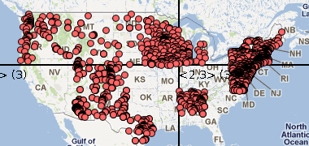
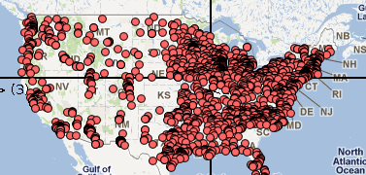
Objectives Example: Pharmacies offering Flu vaccines
A solution considering only maximality
Maximality + fairness

Slide 31
Outline
Thinning problem:
  Formal definitions
  Challenges
General Framework for solving Thinning
Specific solutions

Slide 32
The Thinning Problem: Maximality
Input:
Geoset G = {R1, ..., Rn} over a spatial tree T(Z,N)
Bound K ∈ N on the number of visible records in any cell
Output: a function min-level M : {1,...,n} → {1, …, Z, Z + 1}
Such that: ∀c^{z}_{j}∈N , z ≤ Z: |VisM(G,T, c^{z}_{j})| ≤ K
- VisM(G,T, c^{z}_{j}) is visible records at c^{z}_{j} = {Ri|(c^{z}_{j}∈span(Ri))&(M(j)≤z)}

Slide 33
The Thinning Problem: Maximality
Strong Maximality (Global Maxima):
M is strongly maximal if, does not exists M’ such that:
∀c ∈ N : |VisM(G,T,c)| ≤ |VisM′(G,T,c)|
∃c ∈ N : |VisM(G,T,c)| < |VisM′(G,T,c)|
Thm: Finding a strongly maximal solution is NP-hard in n.
Weak Maximality (Local Maxima): M is weakly maximal if for any M’ with:
M’(i*) < M(i*) for one i*
M’(i) = M(i) for i≠i*
Then, M’ is not a solution.

Slide 34
Sampling based on tree traveral
Algorithm that samples features while traversing spatial tree
Naïve:
  Breadth-first traversal
  Exponential space complexity

Slide 35
DFS Algorithm (overview)
Traverse spatial index tree in top-down depth-first fashion
Until all nodes traversed in DFS:
  Check number L of available features (K at root) based on how many already visible
  Sample L features at node N and set their zoom level
  Assign each feature to child nodes
Theorem:
1) Weakly maximal for all datasets
2) Strongly maximal for datasets with only points
3) Linear time and space complexity

Slide 36
Randomized Points Algorithm
Assign a random number r(fi) for each feature
For each tile T:
  Show top-500 visible features based random number
Key points:
Strongly maximal
Linear offline complexity, constant memory requirement
Can incorporate importance of points

Slide 37
Related Work
Cartographic Generalization
  domain-specific transformation of features
  our work is complementary: (a) help filter features, (b) decide which transformed features to render
Spatial Databases, Top-K, sampling, …

Slide 38
Thanks!
Anish Das Sarma
Google Research
anish.dassarma@gmail.com

